Slide 1
Spine surgery – discussion with the patient
The ”Dialogue support”
www.eurospine.org
A prediction tool based on data from
the Swedish national quality spine register;
Swespine
Peter Fritzell/register manager Swespine

Slide 2
Swespine is a national quality register that since over 20 years is presenting outcome
after surgical spinal procedures on both a departmental and a national level.
The number of patients in Swespine is today 137 000, with appr. 10 000 added yearly.
Opt-out is used as patient approval. Detailed information is given in accordance with GDPR

Slide 3
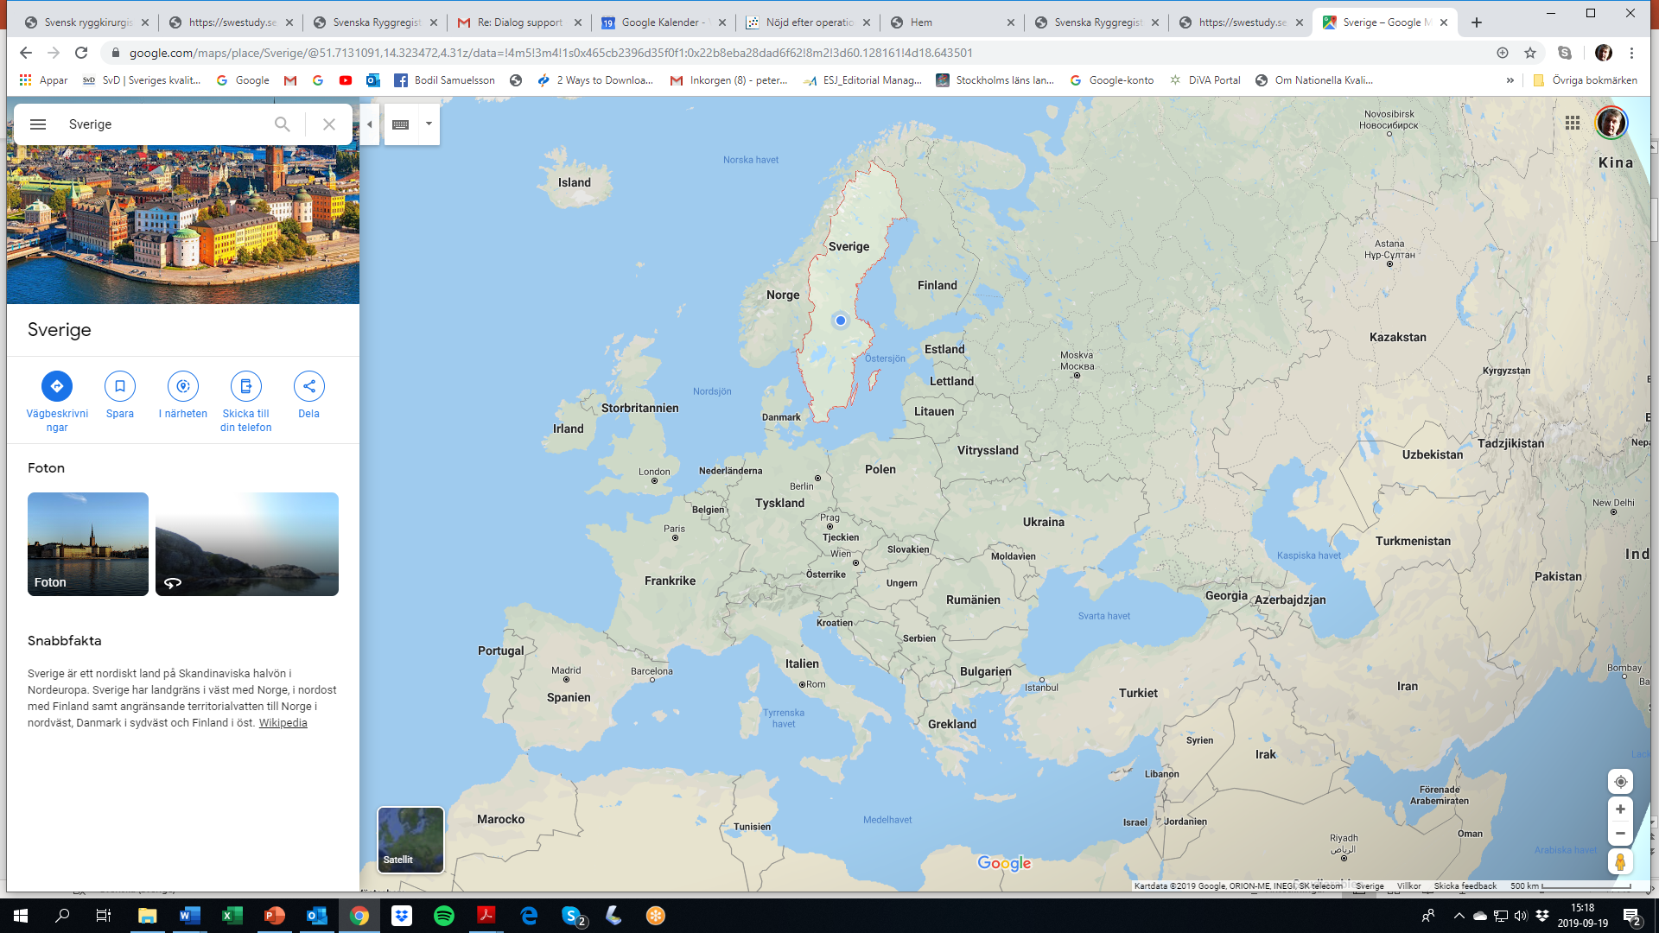
Sweden and Europe
Sweden;
appr. 10 milj. citizens
45-50 ”spine clinics”

Slide 4
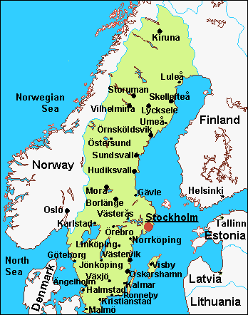
Swespine;
a national web based spine register
since 1998.
On a national level;
Coverage 98%
Completeness 85%
Follow up 75%
Falun
Arvika

Slide 5
Variables included in Swespine – “different mix” for patients;
Variables included in Degenerative lumbar spinal disorders (LDH, LSS, DDD)
Diagnose Type of clinic (University, County hospital, Private clinic) Age Gender Work status Sick pension Retention pension Smoking Quality of life (EQ5D) Walking distance Pain duration LEG Pain duration BACK Preop pain LEG (NRS) Preop pain BACK (NRS) Function (ODI)How was your spine procedure financed? Comorbidity
Are you active in sports? What do you think of your possibilities to return to work? How physical is your current workload? Are you out of work? Since how long have you been unable to work? Type of previous spine procedure Acute or Elective surgery Type of procedure/Index operation How many previous spine procedures? Do you take pain killers for your back/leg pain? Type of instrumentation Type of implant Type of bone transplant Operated from the left/right Antibiotic prophylaxis Postop complications Reoperation during Index stay Type of reop procedure Number of reop

Slide 6
Variables used for ”case-mix adjustment” in Swespine.
These variables have been identified, after statistical analyses, as predictive of patient reported outcome one year after surgery for the following Degenerative lumbar spinal disorders; LDH, LSS, DDD
1. Diagnosis 2. Type of clinic (University, County hospital, Private clinic) 3. Age 4. Gender 5. Work status 6. Sick pension 7. Retention pension 8. Smoking 9. Quality of life (EQ5D) 10. Comorbidity 11. Walking distance 12. Pain duration LEG (months) 13. Pain duration BACK (months) 14. Preop pain LEG (NRS) 15. Preop pain BACK (NRS) 16. Function (ODI)
All Forms in Swespine; https://swestudy.se/SweSpineEng/Index.asp? Press Login to get access.

Slide 7
The importance of adjusting for ”case-mix”
- when comparing results from different clinics

Slide 8
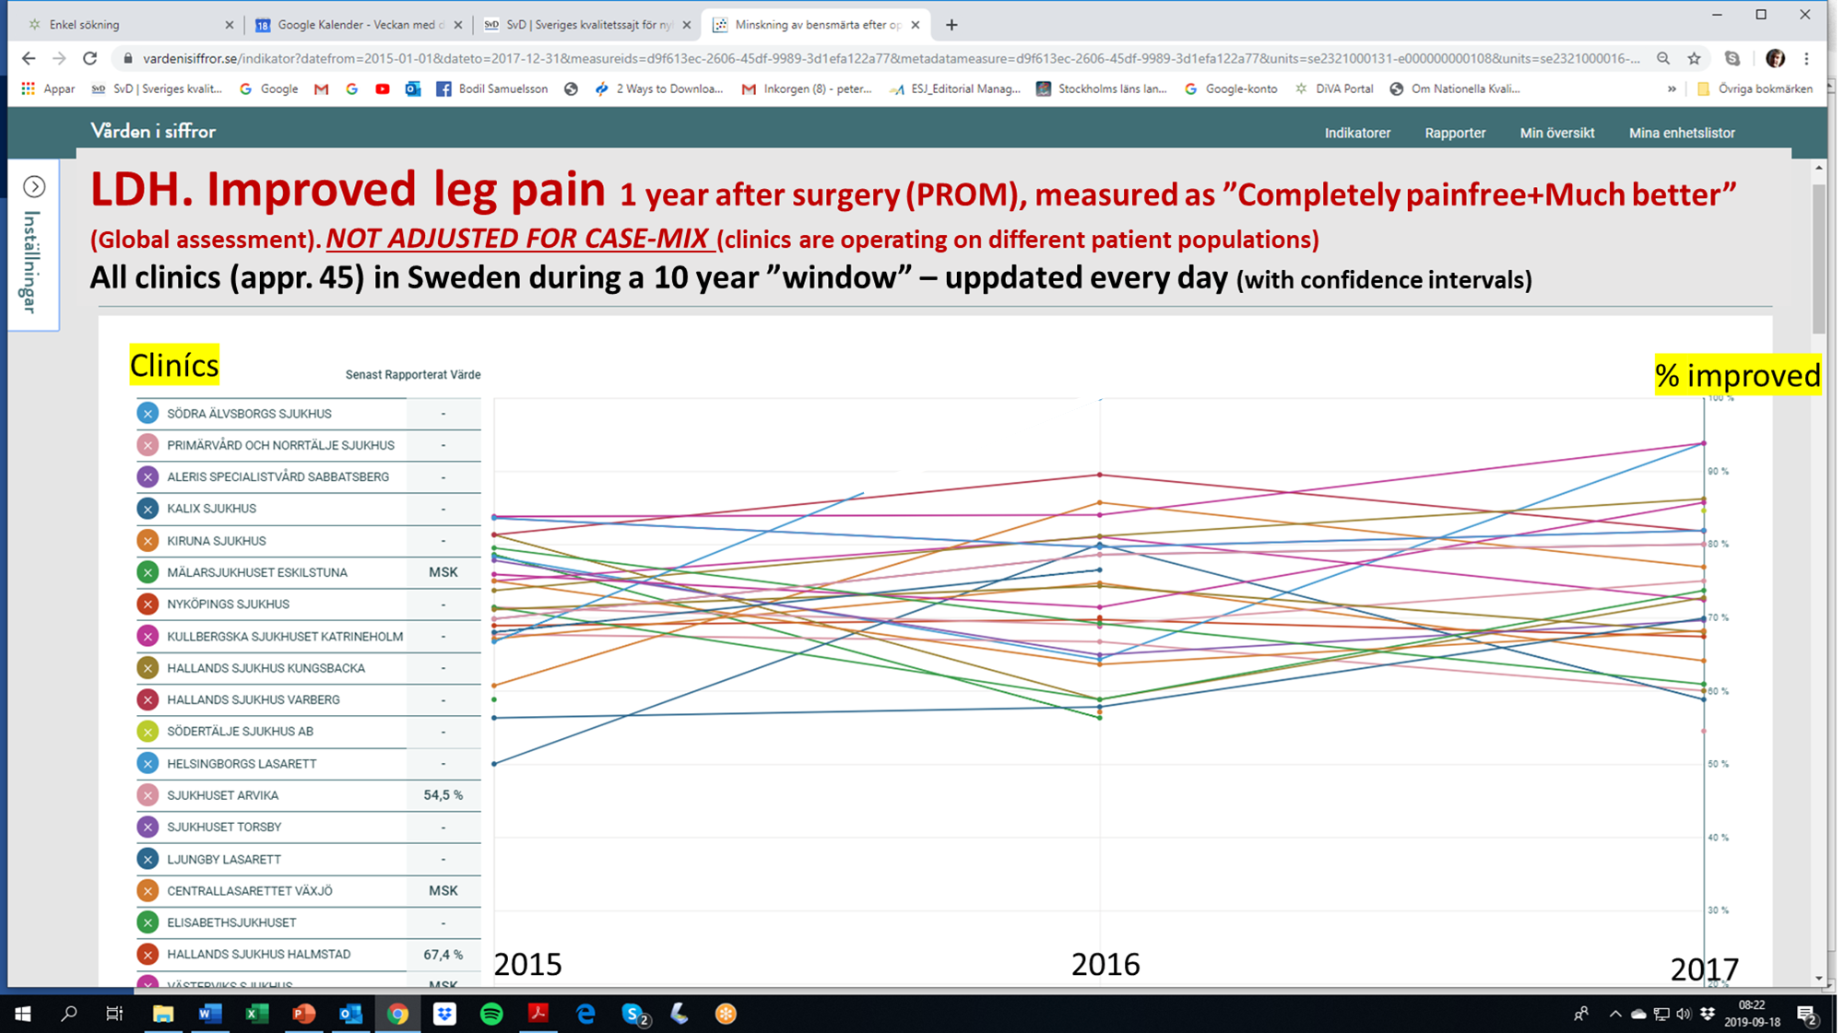
Lumbar Disc Herniation. Improved leg pain – yearly results Swedish clinics
Not adjusted for ”case-mix” – comparing results among clinics

Slide 9
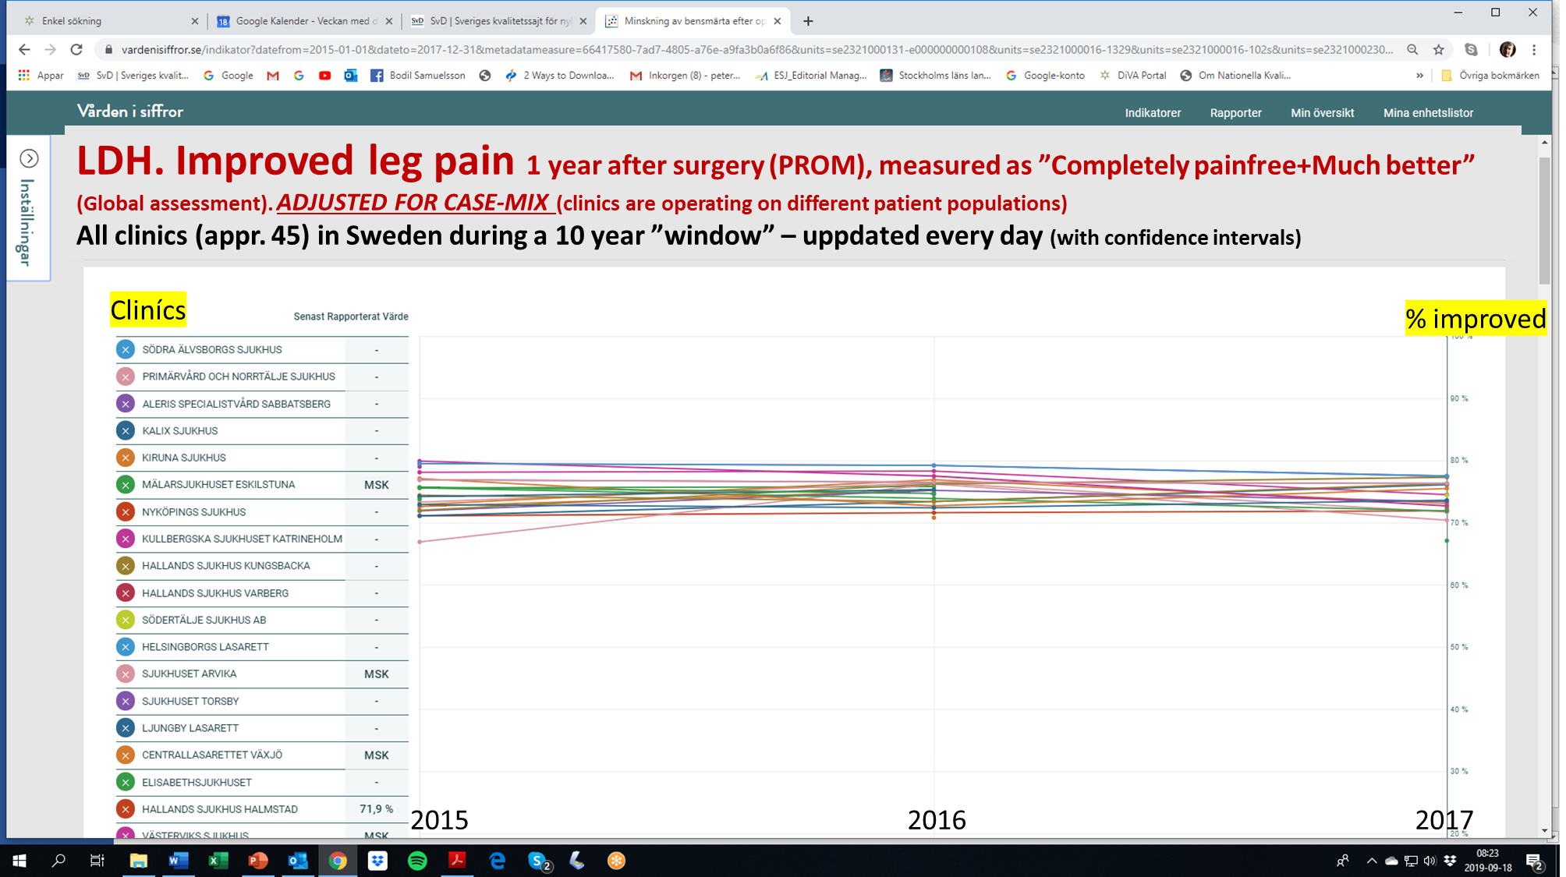
LDH. Improved leg pain 1 year after surgery (PROM), measured as ”Completely painfree+Much better” (Global assessment). ADJUSTED FOR CASE-MIX (clinics are operating on different patient populations)
All Clinics (appr. 45) in Sweden, during a 10 year ”window” – uppdated every day (with conficence intervals)
Lumbar Disc Herniation. Improved leg pain – yearly results Swedish clinics
Adjusted for ”case-mix” – comparing results among clinics

Slide 10
The ”Dialogue support”, is based on national Swespine data in a
”ten year window” - upgraded each year
Each prediction is based on appr. 2-12 000 patients depending on the individual’s profile at baseline.
Together with every prediction the number of patients behind this prediction can be vizualised.

Slide 12
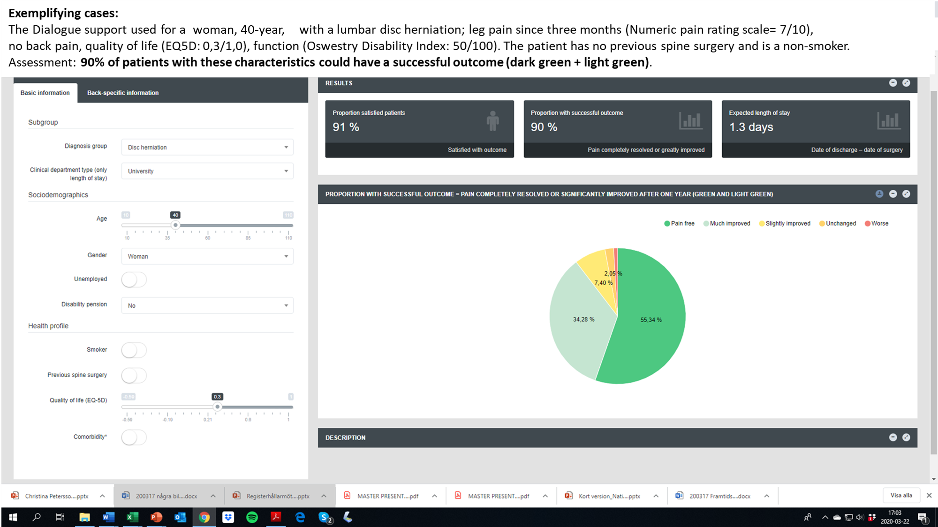

Slide 13
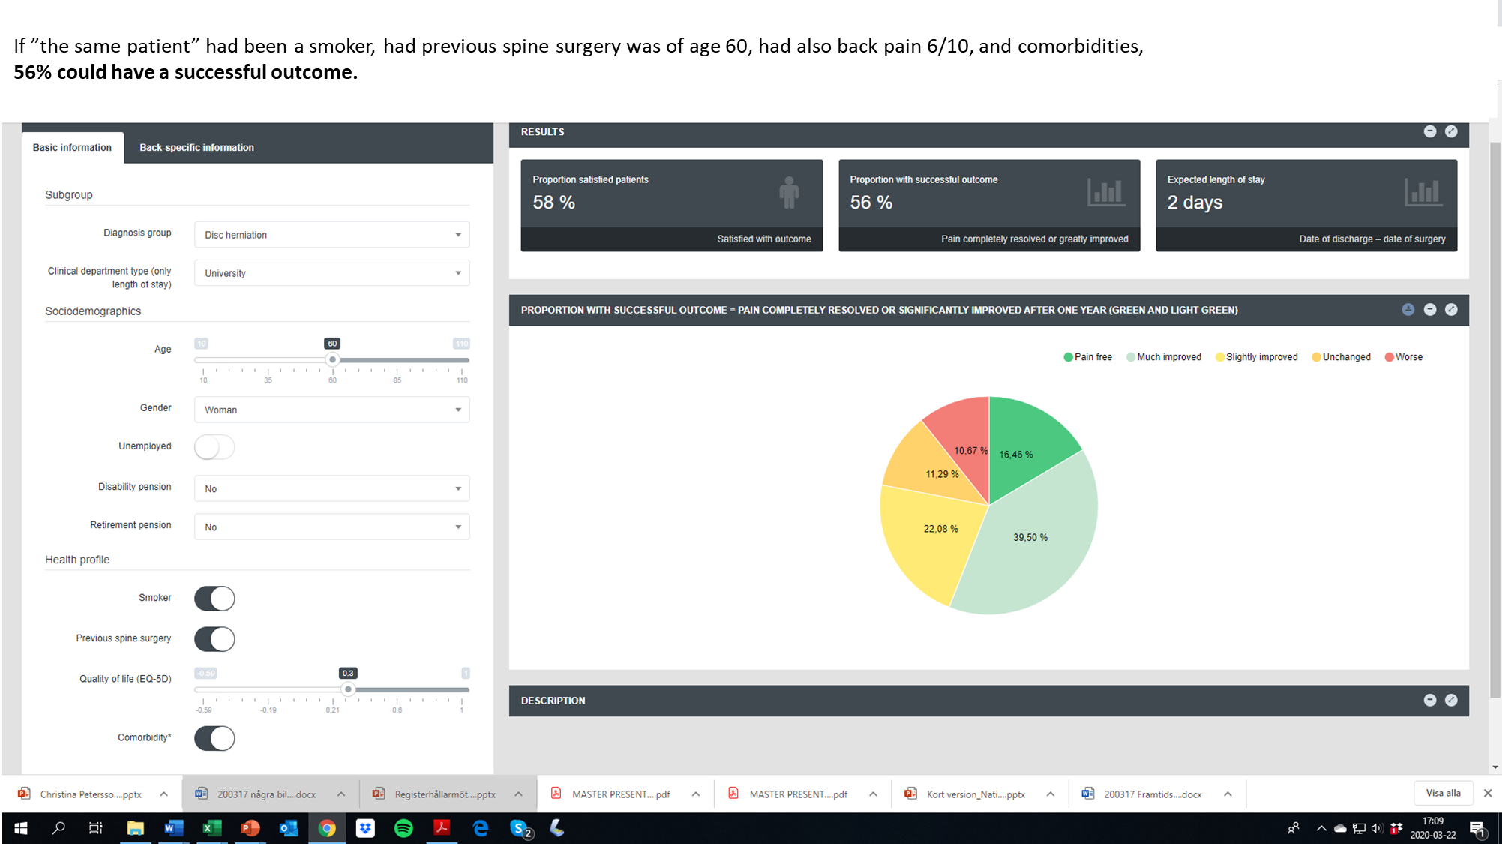
Note that Back specific information is not shown, but variables here should also be selected!

Slide 14
The Dialogue support – important to reflect on
………
……………………………………. ………………………………………………………………………………………………………………………………………………………………………………………………………………………………………………………………………………………………………………………………………………………………………………………………………………………………………………………………………………………………………………………………………………………………………………. …………………………………
……….
…………..
…………………………………………………………………………………….
……….
…………..
…………………………………………………………………………………….

Slide 15
The ”Dialogue Support”
Collaborative research
When you have access to the Dialogue support (DS)on line – studies are possible, f ex;
Retrospective; insert variables from your existing patients in the ”DS” – compare with outcome directly
Prospective; insert variables from your new patients in the ”DS” – compare with outcome after 1 year
*Compare predictive outcome from different clinics and countries with actual outcome
Compare predictive outcome with other Observational studies and also with RCTs
* Several clinics in Sweden are interested in collaboration, f.ex; RKC in Stockholm, SCG in Gothenburg, Uppsala university orthopadec clinic a.s f……….
If you are interested, contact; peterfritzell@gmail.com

Slide 16
On-line on Eurospine Web site
www.eurospine.org
Remember – you always also will have to
use your clincal judgement!

